Slide 1

Predict the “stabilized” rating of movie
April 25, 2020

Slide 2
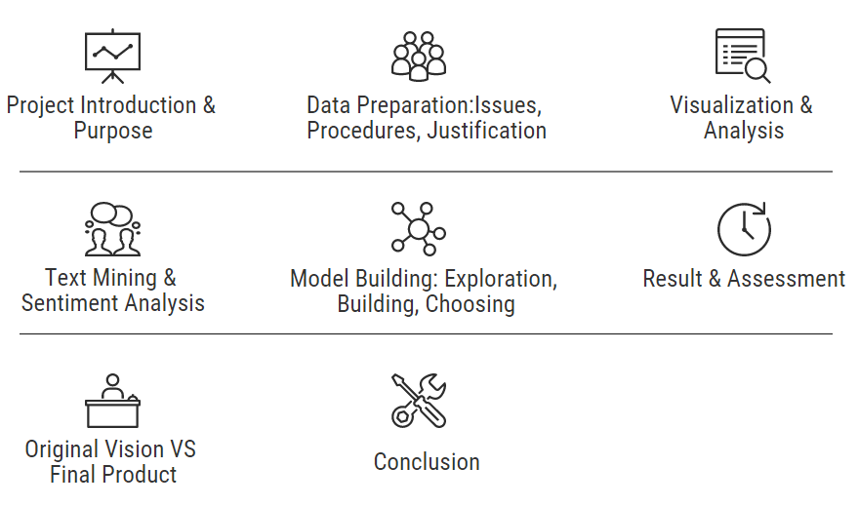
WHAT HAVE WE INCLUDED ..

Slide 3



The Team
Rohan Gupta
Project Manager
A20202192
Pankajdeer Bikumalla
Data Scientist
A20220181
Cyril Johnson
Visualization Expert
A20227721

Slide 4


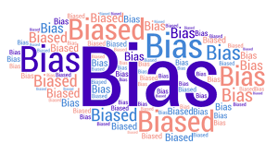

Project Introduction & Purpose
Opening Weekend

Slide 5


Project Introduction & Purpose
Help the movie viewers in taking a better-informed decision, by predicting the stabilized movie rating with the help of movie sentiment in the opening week
People’s pulse
Predict the movie “Rating”
Movie Information:

Slide 6
Data Preparation

Slide 7

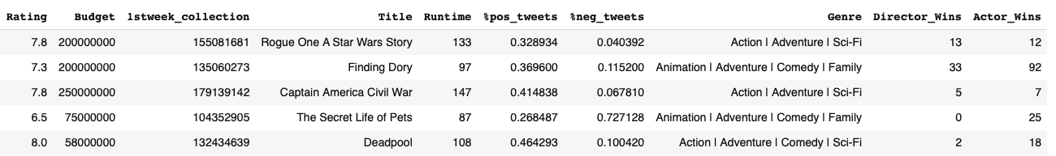
Data Preparation outline
(Text Mining)

Slide 8
Data Preparation
 | Method: Twint library | Method: Selenium
Data Access | Issues: Server was overloaded and crashed multiple times Procedure: Restricted on number of tweets and included a sleep time of 5minutes Justification: Automated the process smoothly | Issues: The code kept breaking during data extration Procedure: Included “refresh” option Justification: Allowing network to pass over fluctuations
Data Consolidation | N/A As it would create a very big file to handle | Issues: Multiple data sources Procedure: Combined dataset Justification: To ease the further analysis

Slide 9
Data Preparation
 | Method: Twint library | Method: Selenium
Data Cleaning | Issues: Many words were not important for the analysis Procedure: Removed handler, short words, punctuations and stop words from tweets Justification: These words doesn’t have any polarity | Issues: Data type was incorrect Procedure: Removed dollar signs, trailing and leading spaces, year in the “movie title” and missing value Justification: These prevented the system to use the actual data types
Data Transformation | Issue: Required sentiment influence for each movie Procedure: Derived positive, negative and neutral popularity rates using tweets Justification: To include sentiment in analysis | Issue: Require to modify no of genre and budget for better analysis Procedure: Derived no. of genres, fraction of budget collected in opening weekend Justification: To better the analysis

Slide 10
Data Reduction - Twitter
Issue: Curse of Dimensionality Procedure: Reduced the number of variables in the data
Variables Removed | Reason
Id, Conversation Id, Created, userid, Username, name, place, urls, photos, hashtags, retweet, tweet_url, reply_to | Not needed in our analysis
Geo, user_rt, user_rt_id, retweet_id | All missing and not needed in analysis
Retweet date | All missing and not needed in analysis

Slide 11
Data Reduction – IMDB
Variables Removed | Reason
S.no, Movie title, IMDB Link, | Not needed in our analysis
Actor Oscars, Director Oscars, Write Oscars, Opening Week Collection | Collinearity/Redundancy

Slide 12
Exploratory analysis

Slide 13
Visualization & Analysis
Plots and graphs
Data Distribution of Target variable: “Rating”
Data Distribution of Input variable: “Run Time (i.e. length of a movie)”
Data Distribution of Input variable: “perc_positive” tweets

Slide 14
Visualization & Analysis
Plots and graphs
Data Distribution of Input variable: “perc_negative” tweets
Boxplot of the variable: “Budget” i.e budget for making the movie (in $)
Boxplot of the variable: “Opening Week Collection”

Slide 15
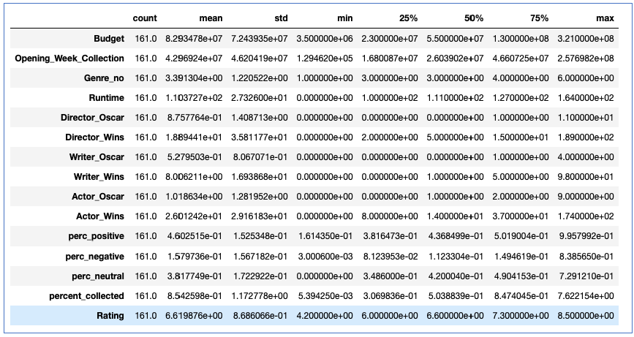
Visualization & Analysis
Plots and Summary Statiscs
Data distribution of the variable “percent_collected”-

Slide 16
Method

Slide 17
Sentiment Analysis
Positive popularity rate
Modeling
Target: Rating
Conclusion
Results & Assessment
Negative popularity rate

Slide 18
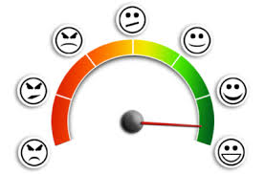


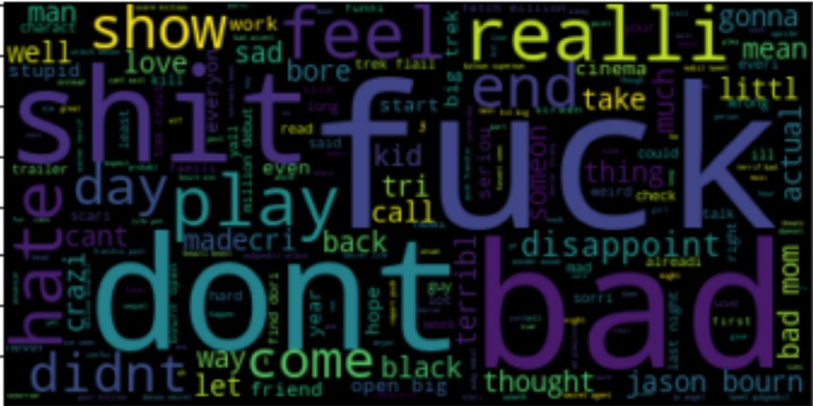
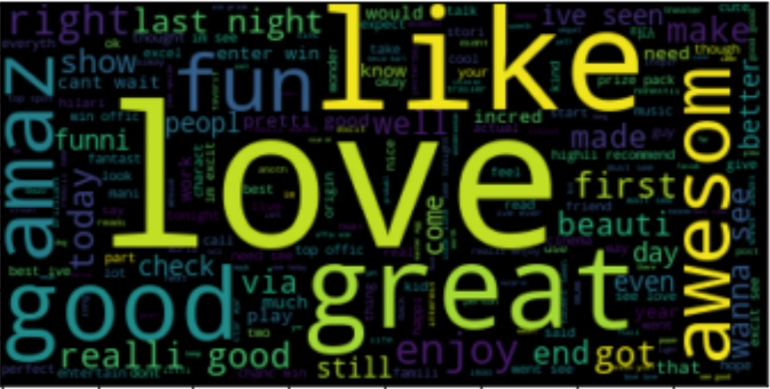
Sentiment Analysis
1. 161 movies: Twint library to extract first 5000 tweets in the opening weekend
2. Using textblob, we derived the sentiment using “polarity score”
3. Used word cloud to validate the working of textblob
TWINT Library
First 5000 Tweets
TEXTBLOB Library
Positive Popularity Rate
Negative
Positive

Slide 19
Sentiment Analysis
TextBlob is a library for processing textual data
A simple API for diving into common natural language processing (NLP) tasks such as part-of-speech tagging, noun phrase extraction, sentiment analysis, classification, translation, and more
Gives polarity score as output, values ranging from (-1 to 1) and can be inferred accordingly as:
TEXTBLOB Library
Polarity Score | Class
< 0 | Negative
> 0 | Positive
= 0 | Neutral

Slide 20
Modeling

Slide 21


Modeling
Dependent variables
Budget
Fraction of budget collected (perc_ collected)
Positive popularity rate
Negative popularity rate
Previous Director Wins
Previous Actor Wins
Previous Writer Wins
Genre Count
Run time
Models
Multiple Linear Regression
Decision Tree
Artificial Neural Network
TARGET VARIABLE
Rating {1 - 10}
Continuous variable
Supervised learning

Slide 22
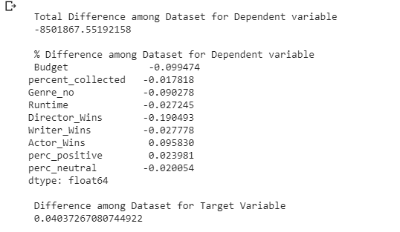
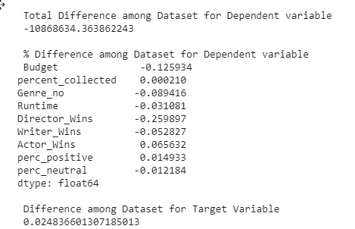
Data Partition
100% Train
100% Test
Dimension: 161 x 10
Method: Bootstrapping
Different Radom states for Train and Test Data
Train & Test Datasets: (161 * 1.0)
90% Train
90% Train
…
…
…
85% Train
85% Test
Difference between train and test increased further ….

Slide 23
Multiple Regression
Explains the linear relation between Target and Independent variables
Weakness
Robustness
Assumptions
Strengths
Explanatory power
Linear Relation
Linear Relation
Less Complex

Slide 24
Decision Tree
Explains the linear relation between Target and Independent variables
Weakness
Strengths
Very Less Assumption
Dynamic: Small changes
Non - linear rules
Model complexity

Slide 25
Neural Network
Inspired from human brain neuron structure
Known as “Black box” model due to its complexity and interpretability difficulties
Weakness
Strengths
Difficulty in Interpretation
High Accuracy
Non - Linear Relations
High Model Complexity
Small datasets: Overfits

Slide 26
Results & Assesment

Slide 27
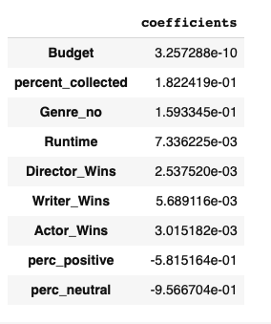
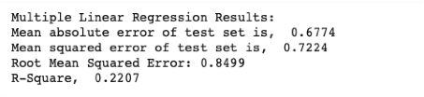
Result Regression

Slide 28
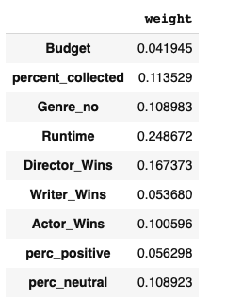
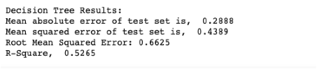
Result Decision Tree

Slide 29
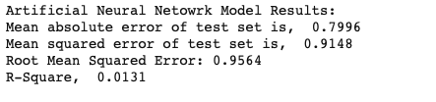
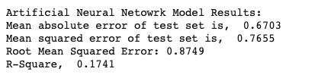
Result: Neural Network
Activation Function: Logistic, Solver: gradient decent
Activation Function: Rectified Linear Unit, Solver: gradient descent

Slide 30
Model Assessment
Model | R _ Square | MAE | RMSE
Linear Regression | 22.07 % | 0.67 | 0.84
Decision Tree | 52.65% | 0.28 | 0.66
Artificial Neural Network | 17.41% | 0.67 | 0.87
Selected model
Notes:
Decision tree model is outperforming compared to other models not only in terms of RMSE but also in other fit statistics, i.e. the explanatory power of the model is also significantly higher compared to other two models, Linear Regression and Artificial Neural Network

Slide 31


Conclusion
Past achievements of lead cast and crew influences more on stabilized movie rating
Positive popularity rate in the opening weekend is less influential on the stabilized movie rating.
Notes:
As R2 is around 52% better than making a guess based on average value, based on first 3 days. They can rely on our model. So it won’t be make or break decision

Slide 32
Original Vision VS Final Product
Original Vision is to predict the stabilized movie rating on IMDB and also, study the influence of people’s pulse (in twitter) on rating
This vision is translated by performing modeling techniques (Machine Learning)
Achieved with an R2 Square value of 52.65%, with the information available on public platforms

Slide 33
Recommendations
As R-Square value is 52%, our model is much better than making a guess based on average rating in general
A movie viewer can confidently rely on our model, and can make decision certainly, as the error in rating prediction is ~0.3 units on average

Slide 34
Thank You!!

Slide 35
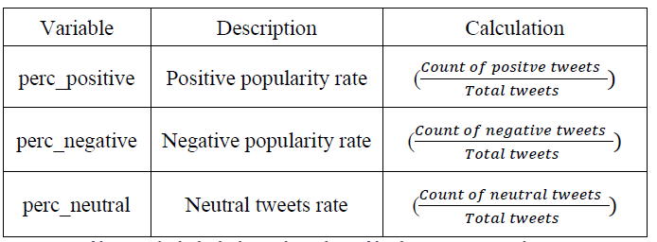
Derived variables
Data Transformation: Twitter

